Slide 1


Dot net with Ajax
Success is not in future it is under your feet Gain knowledge with us
PROF. S. LAKSHMANAN,
DEPT. OF B. VOC. (SD & SA),
ST. JOSEPH'S COLLEGE.

Slide 2



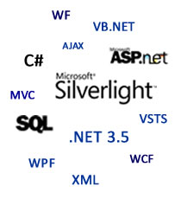

Slide 3


Why Microsoft .NET
"NET is Microsoft's strategy for software that empowers people any time, any place and on any device."
Platform Independent
Language Independent
In .NET you have a choice of languages to code with(C#,VB.NET, J#,Python etc), producing the same type of compiled code. Language Independent
Support More than 44 Languages

Slide 4
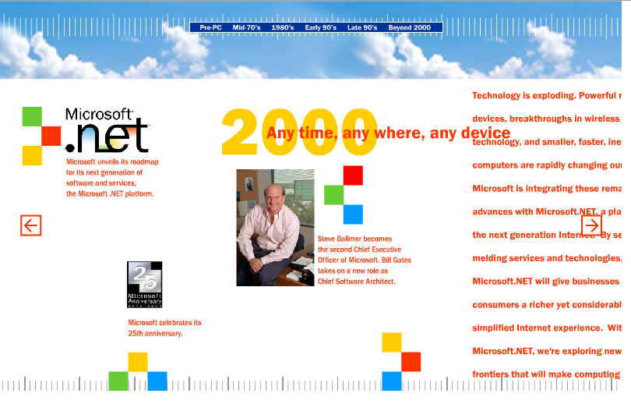
Microsoft .NET

Slide 5
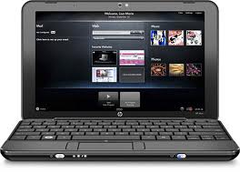

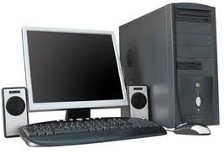



User
Any Device
Any Place
Any Time
Engineering
Sales
Operations
Supply
Customer
Roles/Experience
Get the right info To the right user
At the right time
Authentication
XML Web Services
Integrate and orchestrate business application and process
Scheduling
Notification
Back Office
Heterogeneous application and server infrastructure
Plant
Operation
Customer
Services
ERP & Billing

Slide 6

What is .Net
Microsoft .NET is a software component that runs on the Windows operating system.
.NET provides tools and libraries that enable developers to create Windows software much faster and easier.
.NET benefits end-users by providing applications of higher capability, quality and security.
.NET provides Complete suite of tools for developing and deploying various kind of applications.

Slide 7
Continue…
Microsoft describes .Net (dot net) as its web services platform: it enables a company to develop an IT infrastructure that works across a network, such as the internet.
Applications can be developed very quickly using Visual Studio or the free Visual Studio Express.
Excellent Support for databases and XML
A way for Internet servers to expose functions to any client via WEBSERVICES

Slide 8
.NET Framework
VISUAL BASIC .NET
VB
C#
C++
…
Common Language Specification
ASP.NET
WebForms Web Services
Mobile Internet Toolkit
Windows
Forms
ADO.NET And XML
Base Class Library
Common Language Runtime (CLR)
Operating System Services

Slide 9
.NET Application Execution
Source code
VB
C#
C++
Unmanaged
Component
Compiler
Compiler
Compiler
Managed
code
Assembly
IL Code
Assembly
IL Code
Assembly
IL Code
Common Language Runtime
JIT Compiler
Native Code
Operating System Services

Slide 10
History Of .NET
Microsoft started building .NET in the late 90s under the name “Next Generation Windows Services” (NGWS).
Microsoft announced .NET to the world in June 2000 and released version 1.0 of the .NET framework in January 2002.

Slide 11
Versions of .NET
VERSION | RELEASE | VISUAL STUDIO`
1.0 | 2002-02-13 | Visual Studio .NET
1.1 | 2003-04-24 | Visual Studio .NET 2003
2.0 | 2005-11-07 | Visual Studio 2005
3.0 | 2006-11-06
3.5 | 2007-11-19 | Visual Studio 2008
4.0 | 2010-04-12 | Visual Studio 2010

Slide 12


Why .NET Plays Vital Role in IT Market
We can Develop Variety of application Using .Net Framework
  VB.NET
  ASP.NET
  Mobile Application
  AJAX
  WPF
  WCF
  Silverlight
  SharePoint
  Ms-Office Application

Slide 13
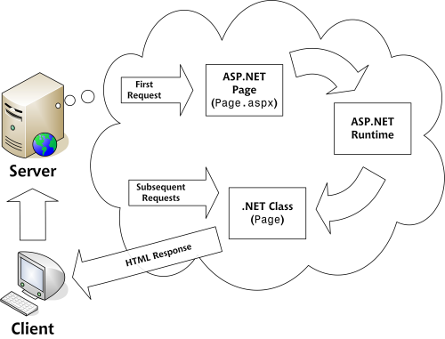
The Life Cycle Of the
ASP.NET Page

Slide 14
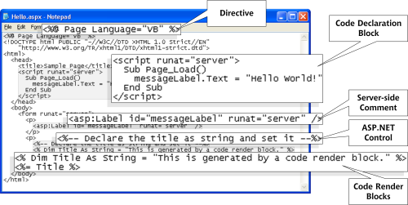
The Parts Of An ASP.NET Page

Slide 15
ASP.NET
Architecture
ASPX
.ASPX

Slide 16
ASP.NET
Architecture
Compiled
.ASPX

Slide 17
ASP.NET
Architecture
Compiled
.ASPX

Slide 18
ASP.NET
Architecture
Compiled
Compiled
.ASPX
.ASPX

Slide 19


Slide 20
Acronym
Asynchronous
JavaScript
And
XML

Slide 21

The Person That Coined The Term AJAX
This asynchronous mode or Ajax architecture is developed by JJ GARET(JESSY JAMES GARET) in the year 2005
The term Ajax also coined by him in the same year.
Garrett, the president of San Francisco Web design boutique Adaptive Path.

Slide 22
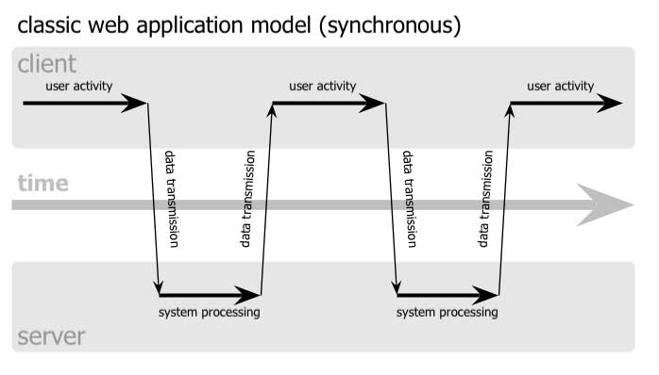
AJAX
In general with out Ajax whatever the request we send to the server from the client is known as synchronous request

Slide 23
Synchronous Request Model
Step1:
User prepares the request at client side
Step2:
Request is send to the server
Step3:
Server will process the request
Step4:
Client gets the response from the server
These steps will repeat again and again as long as user is interact with website.

Slide 24
Disadvantages
1.User idle time is more because until server process the request user need to sit idle
2.Burden on the server will be more because complete client request should be processed by server only.
3.Burden on the network is more, because every thing is coming from server to client.
To overcome these, we use Asynchronous model.

Slide 25
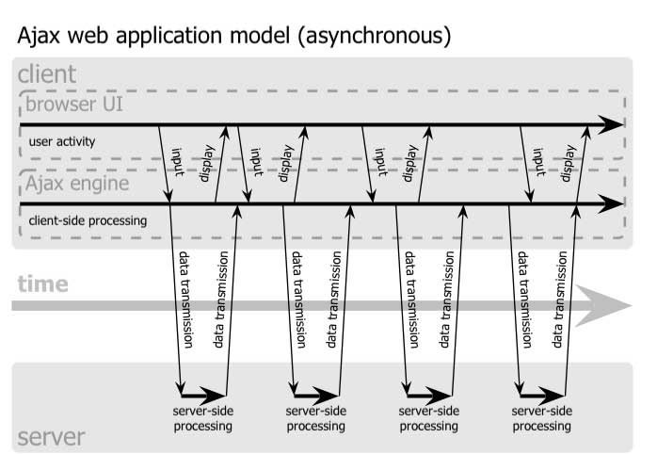
Asynchronous Request Model

Slide 26
Asynchronous Request Model
Step1:
User prepares a request at client side.
Step2:
Request is sent to Ajax engine at client side.
Step3:
Some part of the request will be processed by the Ajax engine at client side only.
Step4:
Request is delivered to server by Ajax engine

Slide 27
Continuation…
Step5:
Ajax engine will deliver response to the user.
Step6:
Server process the request.
Step7:
Result is delivered to the client.
Before response comes from the server user starts preparing other request at client side.
This process will be repeated as long user interacting with the server.

Slide 28
Advantages
1.User idle time is reduced and user will be get very quick response
2.Burden on the server is reduced, because some part of the request is processed by the Ajax Engine only.
3.Burden on the network is reduced, because payload coming from server is less.

Slide 29
AJAX
It is not itself a technology but a group of technologies such as
  HTML
  JavaScript
  CSS (Cascading Style Sheet)
  XML (Extensible Markup Language)
  DOM (Document Object Model)

Slide 30
AJAX
Much of increased client interactivity of web applications
Platform Independent (IE, Firefox, Safari…)
ECMA Script compliant technology –for providing richer UI for browser based cross platform web application.

Slide 31
Why Ajax Become Popular
Sites Like
  Google Mail
  Google Map
  Google Group
  Flickr
  Amazon
  PageFlakes - http://www.pageflakes.com/
  Smart Scoreboard - http://www.smartscoreboard.com/

Slide 32


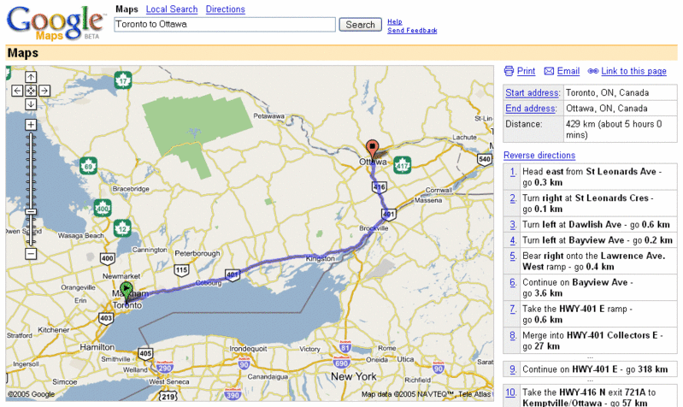


Who Uses AJAX?
Google
  Maps, iGoogle & Gmail
Yahoo!
  MyYahoo! & Yahoo!Mail (beta)
And Many Others…

Slide 33

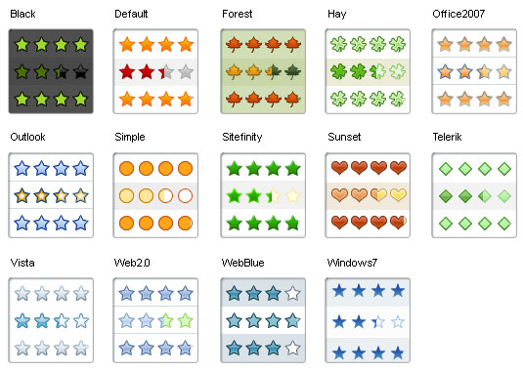
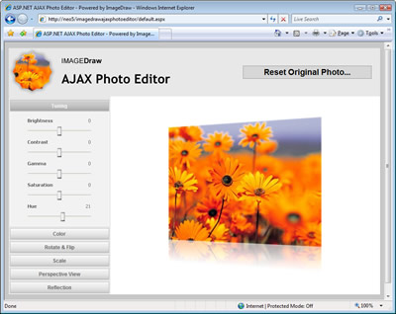
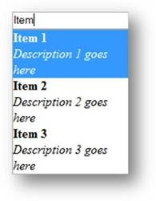
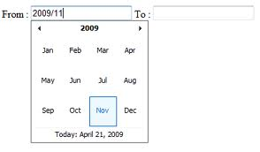
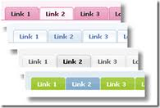


Slide 34
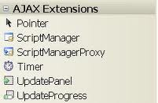
ASP.NET Ajax Server Controls

Slide 35
Developing in Ajax
As we learned before, we must have only one ScriptManager in each page that is using AJAX.
We can put the ScriptManager in a master page and it will apply to all of its child pages.
Updates will occurs in the “Updatepanel” component.
A page can have more then one “Updatepanel”.

Slide 36
Websites Using Ajax
Ajax Based Shopping Sites
HiDefDvd
Ajax Based Home Pages
24eyes
Alesti.org
Claudehussenet.com
Eskobo.com
Favoor.com
Fold.com
Google Personalized
HomePortals
LinkedFeed
Live.com
Magnoto.com
MaxiGate.com
Netvibes PageFlakes
PopUrls
Protopage.com
SmileyToday
Amazon Based Ajax Sites
Amazon.com's AJAX Diamond Search
Drag n Drop DVD Recommendations
TitleZ
Search Engine
AlltheWeb LiveSearch
AskAlexia
DigForIt

Slide 37
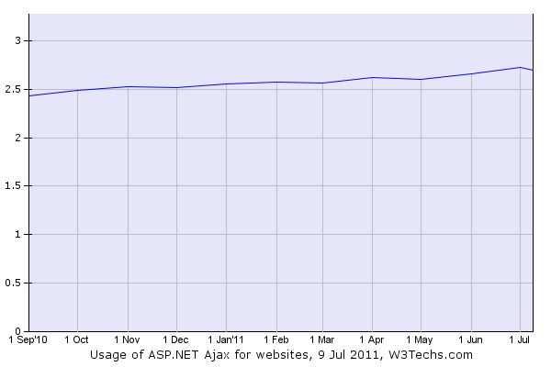
Usage Statistics And Market Share of ASP.NET Ajax For Websites
This diagram shows the historical trend in the percentage of websites using ASP.NET Ajax.

Slide 38






IT Jobs
One of the first steps to matching your skills
Choose your platform.
Be Specialist in your platform.
Learn about the organization.
Have a specific job or jobs in mind.
Review your qualifications for the job.
Relax and answer each question concisely.
Use proper English—avoid slang.

Slide 39

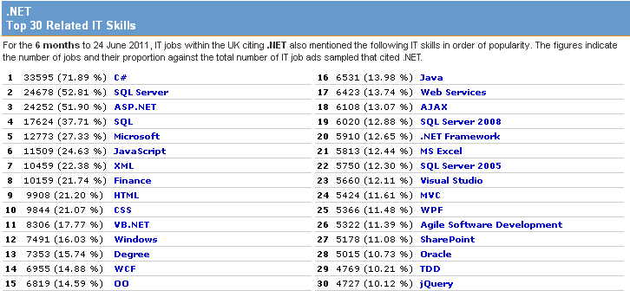
Top 30 Related IT Skills

Slide 40
Thank You.

